Slide 1
Code Contracts for .NET
Manuel Fähndrich
Mike Barnett
Francesco Logozzo

Slide 2
Specifications via Contracts
Precondition
What I expect from the caller?
e.g. A non-null parameter
Postcondition
What I ensure to the caller?
e.g. The returned value is non-negative
Object Invariant
What holds in the stable states of an object?
e.g. This field is non-null

Slide 3
Example: Abs(int x)
public int Abs(int x)
{
if (x < 0)
return -x;
else
return x;
}
Little reminder:
-MinValue==MinValue
Precondition?
Postcondition?
Notes:
Two choices here:
Pre: true
Post: x >= 0 || x == int.MinValue
Or
Pre: x != Int.MinValue
Post: x >= 0

Slide 4
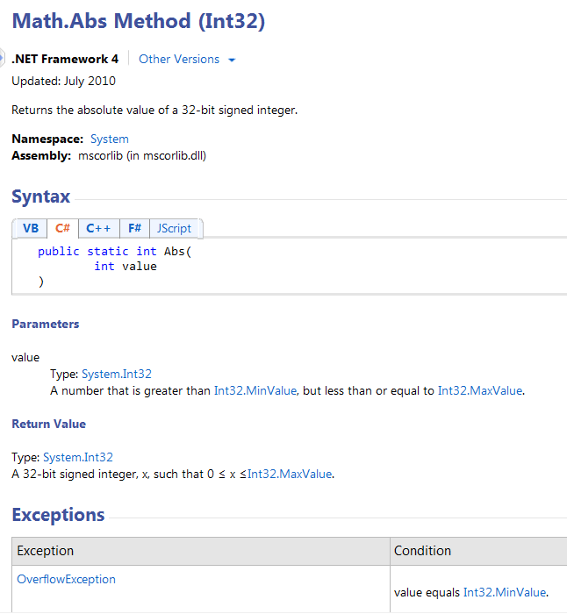
Contracts in MSDN
Precondition
Postcondition

Slide 5
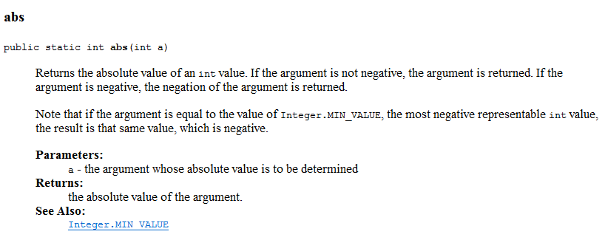
Contracts in Java
Postcondition

Slide 6
What are Code Contracts?
Standard, language-agnostic way to express
Preconditions
Postconditions
Object invariants
Tools for
Documentation generation
Runtime checking of contracts
Static verification

Slide 7
Specification demo!

Slide 8
Goals for Code Contracts
Specify design decisions once
Use many times:
Code documentation
In sync with code
Documentation generation
Runtime checking
Static verification
Don’t change existing .NET dev environment
Languages, IDE, compilers, etc.
Provide a standard specification format
Enable tool eco-system around contracts

Slide 9
Code Contracts in BCL 4.0
Contracts are static method calls
Conditions are Boolean expressions
Shared among .NET Languages
Compiler transparent
Use your favorite compiler!
Language agnostic
Write contracts in your favorite language!
Leverage IDE support
Intellisense, squiggles, debugger …

Slide 10
FAQ: Why not use Assert?
No documentation
Not visible to the caller, intent not clear
Feasible, but code duplication for
Returned values
Object invariants
No inheritance
How can you write assert for
Interfaces?
Abstract methods?

Slide 11
Preconditions
namespace System.Diagnostic.Contracts
{
public static class Contract
{
[Conditional("CONTRACTS_FULL")]
public static void Requires(bool condition) { }
condition must
be true at the entry of the method
only contain pure members
reference members as visible as the method
Requires is conditionally defined

Slide 12
In general
All Contracts API are conditionally defined
Enable different Debug/Release scenarios
All the conditions in contracts must be pure
Purity: No observable side effects
Either a pure mathematical expression
+, - , << …
Or call to a method annotated with [Pure]

Slide 13
Postconditions
namespace System.Diagnostic.Contracts
{
public static class Contract
{
…
[Conditional("CONTRACTS_FULL")]
public static void Ensures(bool condition) { }
condition must
be true at the normal exit of the method
The call to ensures appears before any code
Runtime checking enforced by rewriter
What about
The return value?
The old value?

Slide 14
Return and Old values
namespace System.Diagnostic.Contracts
{
public static class Contract
{
…
[Conditional("CONTRACTS_FULL")]
public static T Result<T>() { return default(T); }
[Conditional("CONTRACTS_FULL")]
public static T OldValue<T>(T v) { return default(T); }
Essentially placeholders
No way to express them in C#/VB/F# …
Question:
Why generics?

Slide 15
Object invariants
Condition valid in the stable states
Specification:
Mark a method with ContractInvariantMethod
Express conditions with Contract.Invariant
[ContractInvariantMethod]
void ObjectInvariant()
{
Contract.Invariant(this.values != null);
Contract.Invariant(this.pos >= 0);
Contract.Invariant(this.pos < this.values.Length);
}

Slide 16
Interface Contracts
[ContractClass(typeof(IListContract<>))]
public interface IList<T> : ICollection<T>
{
void RemoveAt(int index);
}
[ContractClassFor(typeof(IList<>))]
abstract class IListContract<T> : IList<T>
{
public void RemoveAt(int index)
{
Contract.Requires(index >= 0);
Contract.Requires(index < this.Count);
Contract.Ensures(this.Count == Contract.OldValue(this.Count)-1);
}
}

Slide 17
Legacy validation code
public void LegacyRequires(string x)
{
if (x == null)
throw new ArgumentNullException();
Contract.EndContractBlock();
}
Also support via attributes for
Validation methods
Contract abbreviators

Slide 18
Code Contracts Overview
ccrewrite
cccheck
ccdocgen
ccrefgen
Tools
Contracts
BCL 4.0
Authoring
VS2010
Sandcastle
Presentation

Slide 19
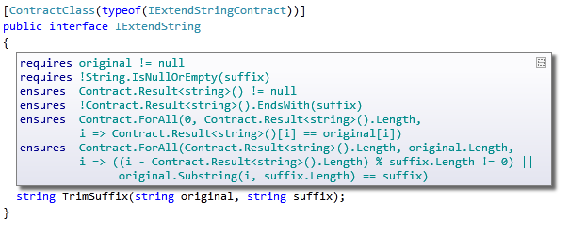
Contract Adornments (VS2010)
Shows inherited contracts
Shows interface contracts on interface
Shows contracts on metadata

Slide 20

Runtime Contract Checking
public virtual int Add(object value)
{
Contract.Requires(object != null);
Contract.Ensures( Count == Contract.Old(Count) + 1 );
Contract.Ensures( Contract.Result<int>() == Contract.OldValue(Count) );
if (_size == _items.Length) EnsuresCapacity(_size + 1);
_items[_size] = value;
return _size++;
}
public virtual int Add(object value)
{
Contract.Requires(object != null);
Contract.Ensures( Count == Contract.Old(Count) + 1 );
Contract.Ensures( Contract.Result<int>() == Contract.OldValue(Count) );
if (_size == _items.Length) EnsuresCapacity(_size + 1);
_items[_size] = value;
return _size++;
}
Executable runtime
Contract checking
csc
/d:CONTRACTS_FULL
.method public hidebysig newslot virtual instance int32 Add(object 'value') cil managed
{
.locals init (int32 'Contract.Old(Count)',
int32 'Contract.Result<int>()')
ldarg.1
ldnull
ceq
ldc.i4.0
ceq
ldstr "value != null"
call void __RewriterMethods::RewriterRequires$PST06000009(bool, string)ldarg.0
ldarg.0
call instance int32 TabDemo.BaseList::get_Count()
stloc.3
ldarg.0
ldfld int32 TabDemo.BaseList::count
ldarg.0
ldfld object[] TabDemo.BaseList::items
ldlen
conv.i4
ceq
ldc.i4.0
ceq
stloc.1
ldloc.1
brtrue IL_004d
nop
ldarg.0
ldarg.0
ldfld int32 TabDemo.BaseList::count
ldc.i4.1
add
call instance void TabDemo.BaseList::EnsureCapacity(int32)
nop
nop
ldarg.0
ldfld object[] TabDemo.BaseList::items
ldarg.0
ldfld int32 TabDemo.BaseList::count
ldarg.1
stelem.ref
ldarg.0
dup
ldfld int32 TabDemo.BaseList::count
dup
stloc.2
ldc.i4.1
add
stfld int32 TabDemo.BaseList::count
ldloc.2
stloc.0
br IL_0072
ldloc.0
stloc.s 'Contract.Result<int>()'
br IL_007a
ldarg.0
call instance int32 TabDemo.BaseList::get_Count()
ldloc.3
ldc.i4.1
add
ceq
ldstr "Count == Contract.Old(Count) + 1"
call void __RewriterMethods::RewriterEnsures$PST0600000B(bool, string)
ldloc.s 'Contract.Result<int>()'
ldloc.s V_4
ceq
ldstr "Contract.Result<int>() == Contract.Old(Count)"
call void __RewriterMethods::RewriterEnsures$PST0600000B(bool, string)
ldloc.s 'Contract.Result<int>()'
ret
}
.method public hidebysig newslot virtual instance int32 Add(object 'value') cil managed
{
ldarg.1
ldnull
ceq
ldc.i4.0
ceq
call void [Microsoft.Contracts]Microsoft.Contracts.Contract::Requires(bool)
ldarg.0
call instance int32 TabDemo.BaseList::get_Count()
ldarg.0
call instance int32 TabDemo.BaseList::get_Count()
call !!0 [Microsoft.Contracts]Microsoft.Contracts.Contract::Old<int32>(!!0)
ldc.i4.1
add
ceq
call void [Microsoft.Contracts]Microsoft.Contracts.Contract::Ensures(bool)
call !!0 [Microsoft.Contracts]Microsoft.Contracts.Contract::Result<int32>()
ldarg.0
call instance int32 TabDemo.BaseList::get_Count()
call !!0 [Microsoft.Contracts]Microsoft.Contracts.Contract::Old<int32>(!!0)
ceq
call void [Microsoft.Contracts]Microsoft.Contracts.Contract::Ensures(bool)
ldarg.0
ldfld int32 TabDemo.BaseList::count
ldarg.0
ldfld object[] TabDemo.BaseList::items
ldlen
conv.i4
ceq
ldc.i4.0
ceq
stloc.1
ldloc.1
brtrue.s IL_0069
ldarg.0
ldarg.0
ldfld int32 TabDemo.BaseList::count
ldc.i4.1
add
call instance void TabDemo.BaseList::EnsureCapacity(int32)
ldarg.0
ldfld object[] TabDemo.BaseList::items
ldarg.0
ldfld int32 TabDemo.BaseList::count
ldarg.1
stelem.ref
ldarg.0
dup
ldfld int32 TabDemo.BaseList::count
dup
stloc.2
ldc.i4.1
add
stfld int32 TabDemo.BaseList::count
ldloc.2
stloc.0
br.s IL_008b
ldloc.0
ret
} // end of method BaseList::Add
csc normal compile
.method public hidebysig newslot virtual instance int32 Add(object 'value') cil managed
{
ldarg.0
ldfld int32 TabDemo.BaseList::count
ldarg.0
ldfld object[] TabDemo.BaseList::items
ldlen
conv.i4
ceq
ldc.i4.0
ceq
stloc.1
ldloc.1
brtrue.s IL_0029
ldarg.0
ldarg.0
ldfld int32 TabDemo.BaseList::count
ldc.i4.1
add
call instance void TabDemo.BaseList::EnsureCapacity(int32)
ldarg.0
ldfld object[] TabDemo.BaseList::items
ldarg.0
ldfld int32 TabDemo.BaseList::count
ldarg.1
stelem.ref
ldarg.0
dup
ldfld int32 TabDemo.BaseList::count
dup
stloc.2
ldc.i4.1
add
stfld int32 TabDemo.BaseList::count
ldloc.2
stloc.0
br.s IL_004b
ldloc.0
ret
}
ccrewrite
WF checks
Inheritance
Invariants
Source text

Slide 21
Runtime checking demo!

Slide 22
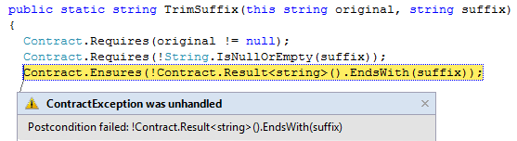
Runtime Checking Experience
Stepping, breakpoints work naturally
Runtime failure behavior fully configurable
Failing condition string available at runtime

Slide 23
Runtime Checking Functionality
Inheritance
Base and interfaces
Granularity knobs
Which checks are inserted
Closures and Iterators
Call-site checking
Recursion guards
Source text extraction
Debug experience/stepping/breakpoints

Slide 24

Contract Reference Assemblies
public virtual int Add(object value)
{
Contract.Requires(object != null);
Contract.Ensures( Count == Contract.Old(Count) + 1 );
Contract.Ensures( Contract.Result<int>() == Contract.OldValue(Count) );
if (_size == _items.Length) EnsuresCapacity(_size + 1);
_items[_size] = value;
return _size++;
}
public virtual int Add(object value)
{
Contract.Requires(object != null);
Contract.Ensures( Count == Contract.Old(Count) + 1 );
Contract.Ensures( Contract.Result<int>() == Contract.OldValue(Count) );
if (_size == _items.Length) EnsuresCapacity(_size + 1);
_items[_size] = value;
return _size++;
}
Compile
/d:CONTRACTS_FULL
Contract Reference Assembly
.method public hidebysig newslot virtual instance int32 Add(object 'value') cil managed
{
ldarg.1
ldnull
ceq
ldc.i4.0
ceq
call void [Microsoft.Contracts]Microsoft.Contracts.Contract::Requires(bool)
ldarg.0
call instance int32 TabDemo.BaseList::get_Count()
ldarg.0
call instance int32 TabDemo.BaseList::get_Count()
call !!0 [Microsoft.Contracts]Microsoft.Contracts.Contract::Old<int32>(!!0)
ldc.i4.1
add
ceq
call void [Microsoft.Contracts]Microsoft.Contracts.Contract::Ensures(bool)
call !!0 [Microsoft.Contracts]Microsoft.Contracts.Contract::Result<int32>()
ldarg.0
call instance int32 TabDemo.BaseList::get_Count()
call !!0 [Microsoft.Contracts]Microsoft.Contracts.Contract::Old<int32>(!!0)
ceq
call void [Microsoft.Contracts]Microsoft.Contracts.Contract::Ensures(bool)
ldarg.0
ldfld int32 TabDemo.BaseList::count
ldarg.0
ldfld object[] TabDemo.BaseList::items
ldlen
conv.i4
ceq
ldc.i4.0
ceq
stloc.1
ldloc.1
brtrue.s IL_0069
ldarg.0
ldarg.0
ldfld int32 TabDemo.BaseList::count
ldc.i4.1
add
call instance void TabDemo.BaseList::EnsureCapacity(int32)
ldarg.0
ldfld object[] TabDemo.BaseList::items
ldarg.0
ldfld int32 TabDemo.BaseList::count
ldarg.1
stelem.ref
ldarg.0
dup
ldfld int32 TabDemo.BaseList::count
dup
stloc.2
ldc.i4.1
add
stfld int32 TabDemo.BaseList::count
ldloc.2
stloc.0
br.s IL_008b
ldloc.0
ret
} // end of method BaseList::Add
.method public hidebysig newslot virtual instance int32 Add(object 'value') cil managed
{
ldarg.1
ldnull
ceq
ldc.i4.0
ceq
call void [Microsoft.Contracts]Microsoft.Contracts.Contract::Requires(bool)
ldarg.0
call instance int32 TabDemo.BaseList::get_Count()
ldarg.0
call instance int32 TabDemo.BaseList::get_Count()
call !!0 [Microsoft.Contracts]Microsoft.Contracts.Contract::Old<int32>(!!0)
ldc.i4.1
add
ceq
call void [Microsoft.Contracts]Microsoft.Contracts.Contract::Ensures(bool)
call !!0 [Microsoft.Contracts]Microsoft.Contracts.Contract::Result<int32>()
ldarg.0
call instance int32 TabDemo.BaseList::get_Count()
call !!0 [Microsoft.Contracts]Microsoft.Contracts.Contract::Old<int32>(!!0)
ceq
call void [Microsoft.Contracts]Microsoft.Contracts.Contract::Ensures(bool)
} // end of method BaseList::Add
ccrefgen

Slide 25
Contract Reference Assemblies
Contract Reference Assemblies
.method public hidebysig newslot virtual instance int32 Add(object 'value') cil managed
{
ldarg.1
ldnull
ceq
ldc.i4.0
ceq
call void [Microsoft.Contracts]Microsoft.Contracts.Contract::Requires(bool)
ldarg.0
call instance int32 TabDemo.BaseList::get_Count()
ldarg.0
call instance int32 TabDemo.BaseList::get_Count()
call !!0 [Microsoft.Contracts]Microsoft.Contracts.Contract::Old<int32>(!!0)
ldc.i4.1
add
ceq
call void [Microsoft.Contracts]Microsoft.Contracts.Contract::Ensures(bool)
call !!0 [Microsoft.Contracts]Microsoft.Contracts.Contract::Result<int32>()
ldarg.0
call instance int32 TabDemo.BaseList::get_Count()
call !!0 [Microsoft.Contracts]Microsoft.Contracts.Contract::Old<int32>(!!0)
ceq
call void [Microsoft.Contracts]Microsoft.Contracts.Contract::Ensures(bool)
ldarg.0
ldfld int32 TabDemo.BaseList::count
ldarg.0
ldfld object[] TabDemo.BaseList::items
ldlen
conv.i4
ceq
ldc.i4.0
ceq
stloc.1
ldloc.1
brtrue.s IL_0069
ldarg.0
ldarg.0
ldfld int32 TabDemo.BaseList::count
ldc.i4.1
add
call instance void TabDemo.BaseList::EnsureCapacity(int32)
ldarg.0
ldfld object[] TabDemo.BaseList::items
ldarg.0
ldfld int32 TabDemo.BaseList::count
ldarg.1
stelem.ref
ldarg.0
dup
ldfld int32 TabDemo.BaseList::count
dup
stloc.2
ldc.i4.1
add
stfld int32 TabDemo.BaseList::count
ldloc.2
stloc.0
br.s IL_008b
ldloc.0
ret
} // end of method BaseList::Add
ccrewrite
Runtime checks
cccheck
Compile-time warnings
ccdocgen
Augmented Xml doc

Slide 26
Providing Contracts for your Lib
src
src
src
src
Release Assemblies
Contract Reference Assemblies
PowerLib.dll
PowerLib.Contracts.dll
+
(minimal runtime checks)
All contracts, no code

Slide 27
Developing against 3rd Party Lib
can check Requires of PowerLib at call-sites
inherits contracts
src
src
src
MyApp.exe
MyApp.exe
src
ccrewrite
PowerLib.Contracts.dll
PowerLib.dll
(no runtime checks)

Slide 28
Contracts for Existing Libraries
Mscorlib
System
System.Data
System.Xml
System.Windows
System.Core
System.Configuration
System.Web
System.Windows.Browser
System.Windows.Forms
WindowsBase
System.Drawing
System.Security
Microsoft.VisualBasic.Compatibility
System.Xml.Linq
Microsoft.VisualBasic

Slide 29
Static contract checking demo!

Slide 30
What the static checker does?
Method level deep static analysis
(Abstract Interpretation)
Assume the precondition
Discover facts on the method
Use facts to prove:
Assertions
Preconditions at call site
Postcondition
Object-invariant
Non-null, index in bounds …

Slide 31
Static contract checking
No silver bullet
False warnings
Prefast/FxCop
Masking
SAL
Annotate
Contracts
More expressive annotations
Runtime checked
Annotation Overhead
Precision
Performance
Noise
Notes:
We feel we have a better handle.

Slide 32
Be careful!
Static checking requires time and effort
Add many contracts
Focus your attention on critical code
ContractVerificationAttribute
Gradually enlarge to the whole codebase
Actively working on the static checker
Try it and provide feedback
Forum
Email

Slide 33
Conclusions
Contracts authoring today with BCL 4.0!
Additional library otherwise
Generate documentation
Download the extension from VS Gallery
Amplify testing
Runtime checking
Pex (next ☺ )
Static checking
More annotations
Compile-time guarantees
Download/comments on DevLabs

